Slide 1


Apollo
Cameron Maywood, Daniel Holmes, Tyler Aratani, Jaden Grossman, Zhaozhong Peng

Slide 2


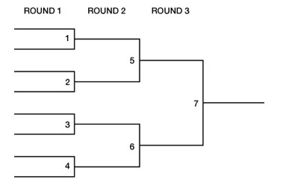
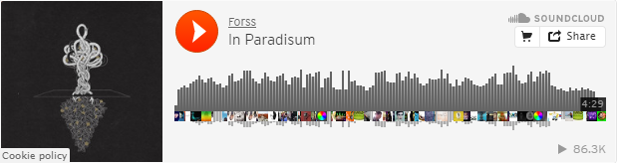
Overview
Purpose:
Provide users with engaging medium for music discovery.
Provide artists with competitive, high-exposure music platform.
Function:
Bracket-style tournaments.
SoundCloud API integration.
Implementation:
Front-end: HTML, JavaScript, CSS
Back-end: PHP, MySQL

